Slide 1

Programmatic vs. Declarative dojo
  Different styles of programming

Slide 2

Programmatic vs. Declarative dojo
Lesson Content:
    What is the declarative style ?
    What is the programmatic style ?
    Hello ,Prog! in the programmatic style
    Mixing and matching styles
    Which style should you choose ?

Slide 3

What is the declarative style?
It is the style discussed up till now involving putting dojoType attributes and having Dojo parse and modify the document on load using “djConfig="parseOnLoad: true"
It is the common way of using Dojo and the closest in spirit to old style HTML

Slide 4
What is the programmatic style?
Sometimes we do not know what widgets we will want to create
This can be a result of a flexible user interface, reading the definition of the user interface from some source (e.g database)‏
This can also be a result of writing a layer on top of Dojo (e.g higher level framework)‏

Slide 5
How is it done?
Simply instantiate a Dojo widget in some Javascript code (in a <script> tag for instance).
For example:
How do you know how to construct the object? RTFM...
var newButton = new dijit.form.Button({label: "Dynamic Button"},placeHolderDiv);

Slide 6
How is it done?
Constructors usually take two parameters:
  An object whose attributes reflect the attributes of the widget (for example, label for a button).
  A place holder element. When the widget is created, it replaces that element in the DOM tree. You can get that via dojo.byId(), srcNodeRef, domNode or any other method to get DOM elements.

Slide 7
Calling startup()‏
Some widgets (especially the layout widgets that contain other children) require the startup() method be called to fully organize itself.
It is a good idea to call startup() for all complex widgets.

Slide 8
Hello, Prog!
<script type="text/javascript">
dojo.require("dijit.form.Button");
var i = 0;
function createButton() {
var parentDiv = dojo.byId("parent");
var newDiv = document.createElement("div");
++i;
newDiv.id = "button" + i;
parentDiv.appendChild(newDiv);
console.debug("creating button: " + newDiv.id);
var newidget=new dijit.form.Button({label: "Dynamic Button" + i},
newDiv);
newidget.startup();
}
</script>

Slide 9

Hello, Prog! (cont)‏
<body class="tundra">
<div dojoType="dijit.form.Button" widgetId="helloButton" onClick="createButton();">Create button...
</div>
<div id="parent">
</div>
</body>
Notice we prepared the parent div to get the new widgets...

Slide 10
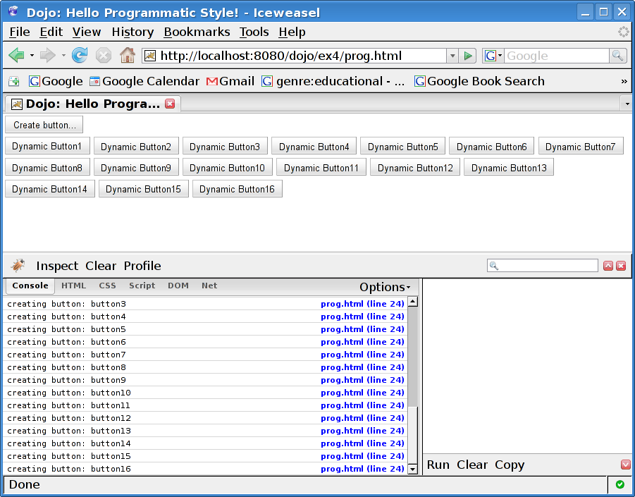
Hello, Prog! (result)‏
And the amazing result:

Slide 11
Mixing and matching styles
Can you use both programmatic and declarative styles in one page or one application? Yes!
Actually, it is the most common case of programmatic style use (as in our example)‏
At core, Dojo is written in the programmatic style and the declarative is a parser on top of it.

Slide 12
Which style to choose?
There is no easy answer.
On most applications and especially for beginners, declarative is the right choice.
If you find you're repeating yourself then the programmatic style could be the answer.
On the other hand writing a new widget may save the day also...

Slide 13
Which style to choose? (cont)‏
If you are the “core technology” of the company then programmatic style may be more to your liking.
If you need to produce huge amounts of pages by distributed teams then declarative seems right.
If your user interface is supposed to be configurable by the user then use prog style

